Slide 1
Operating System
Design Options

Slide 2
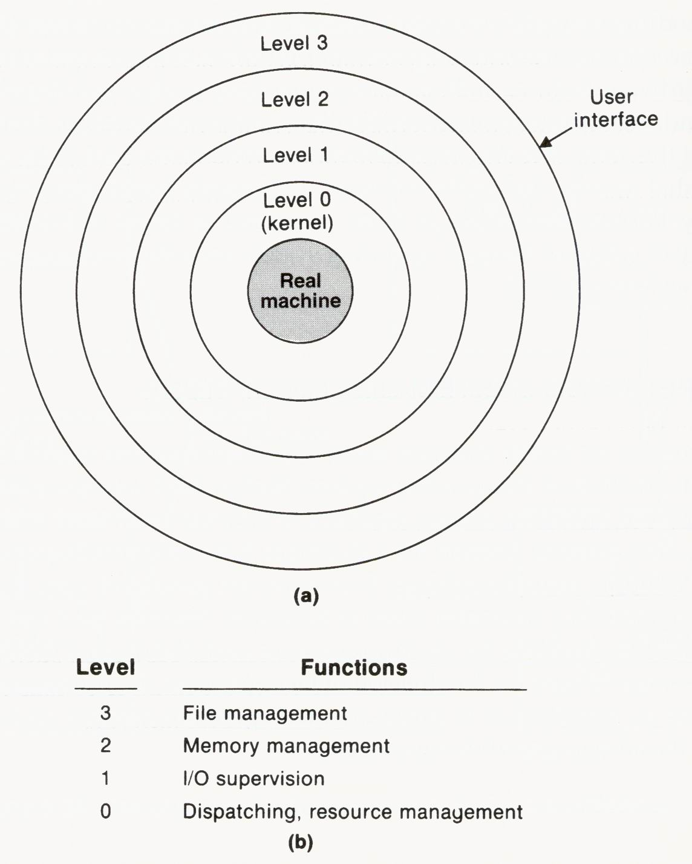
Hierarchical Structure
Many OS are designed and implemented using a hierarchical structure.
Functions at one level are allowed to refer only to functions provided by the same or lower levels; i.e., there should be no outward calls.
Strict hierarchy vs. transparent hierarchy

Slide 3
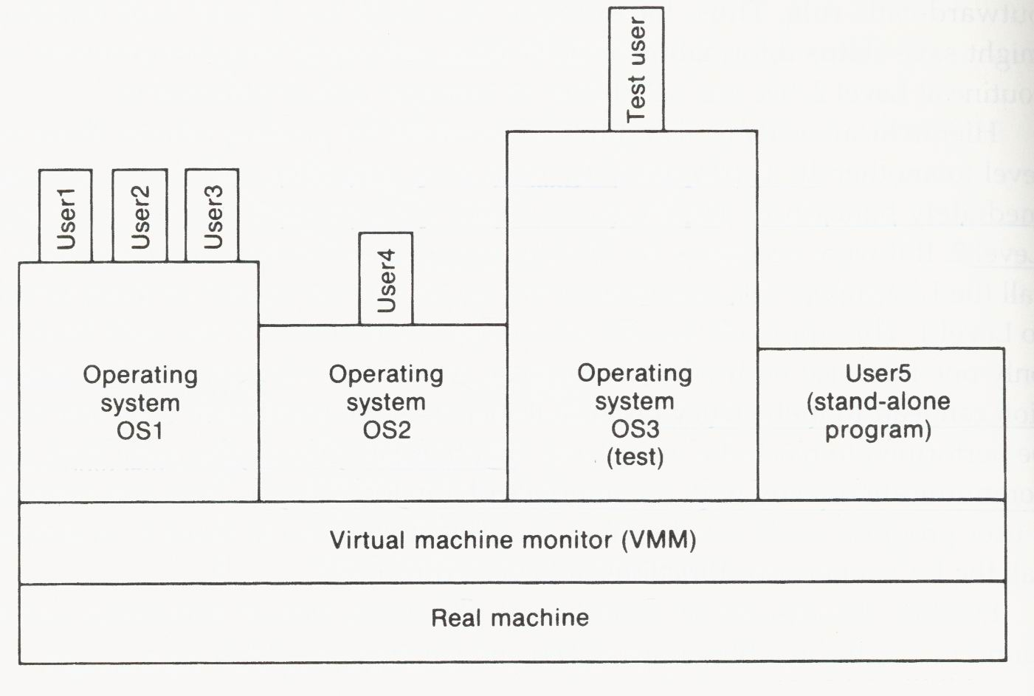
Virtual Machines
Hierarchical structure concepts can be extended to provide users, including OSs, the illusion of running on separate virtual machines.
OS1, OS2, OS3, and User5 deal with the VMM, instead of the real machine.

Slide 4
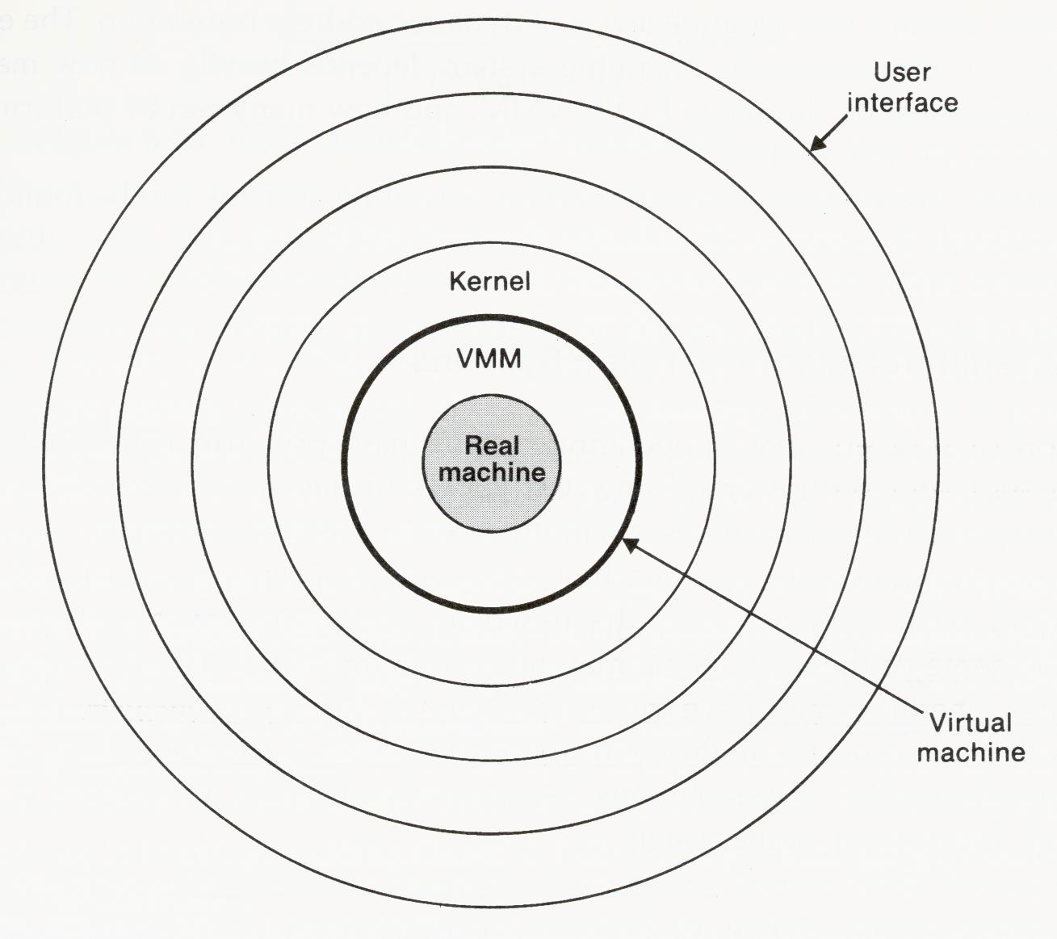
Virtual Machines
VMM provides resources, services, and functions that are the same as those available on the underlying real machine.
VMM is actually a complete, but simple, OS for the real machine.
Pros: flexibility and convenience
Cons: simulation overhead

Slide 5
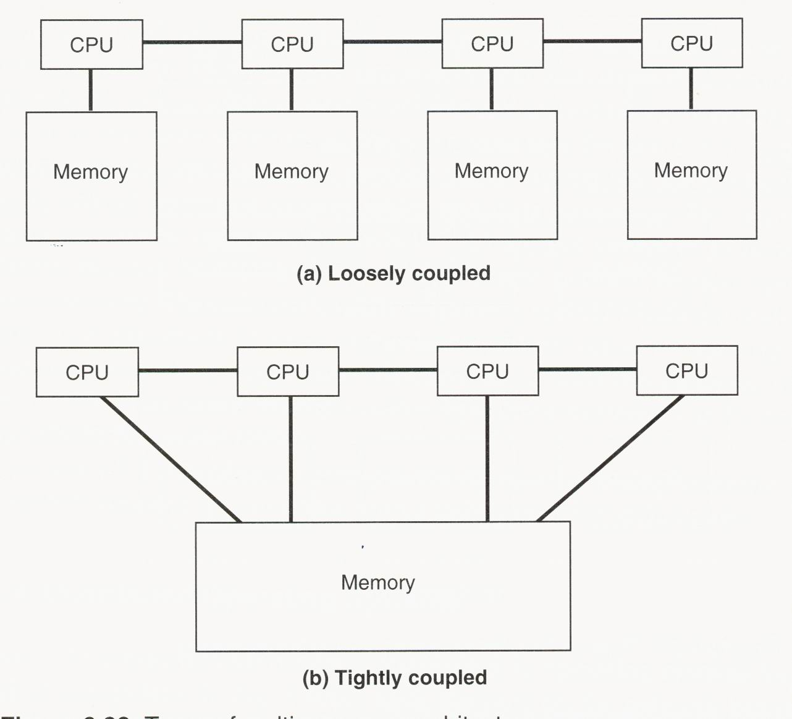
Multiprocessor OSs
Types of multiprocessor architecture

Slide 6
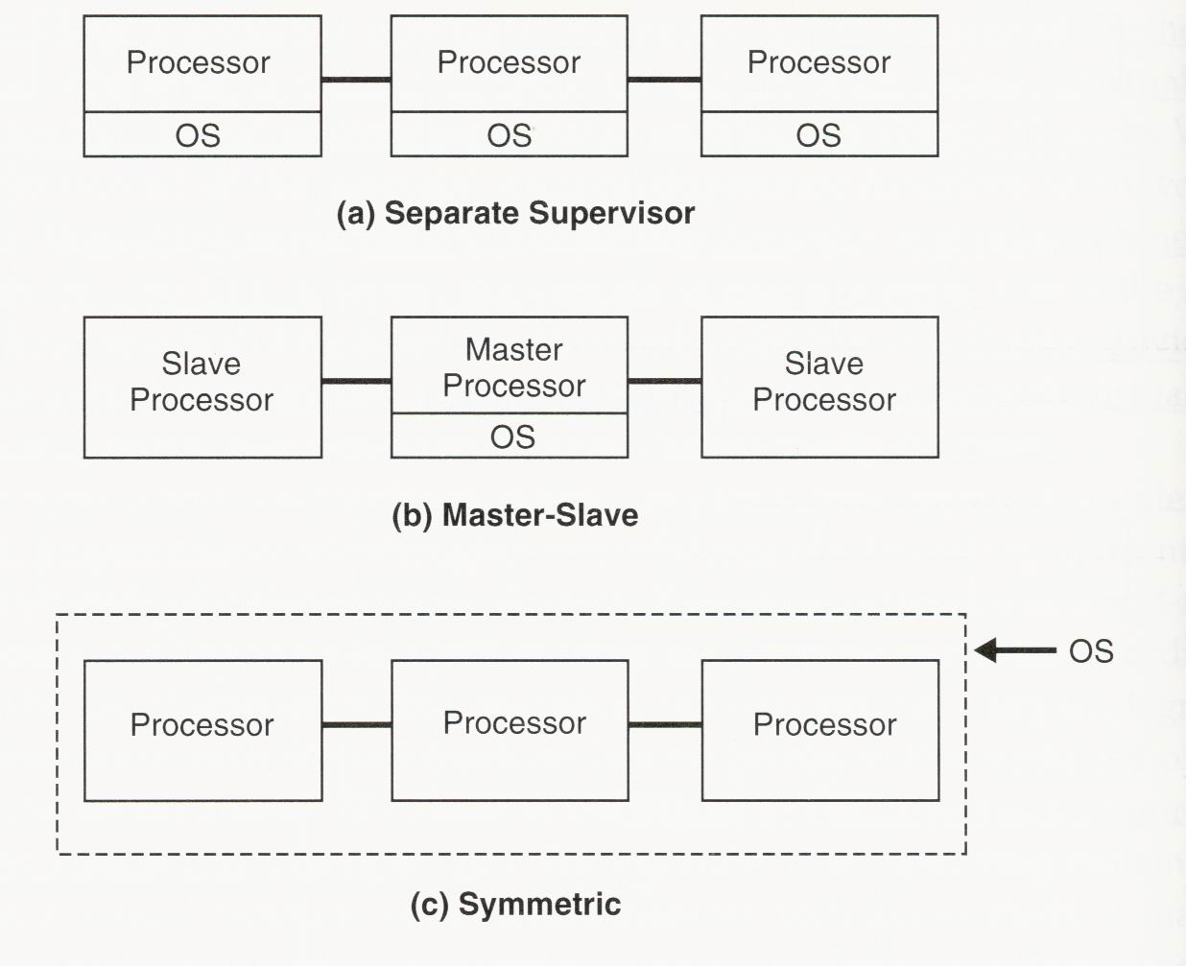
Multiprocessor OSs
Types of multiprocessor OSs:

Slide 7
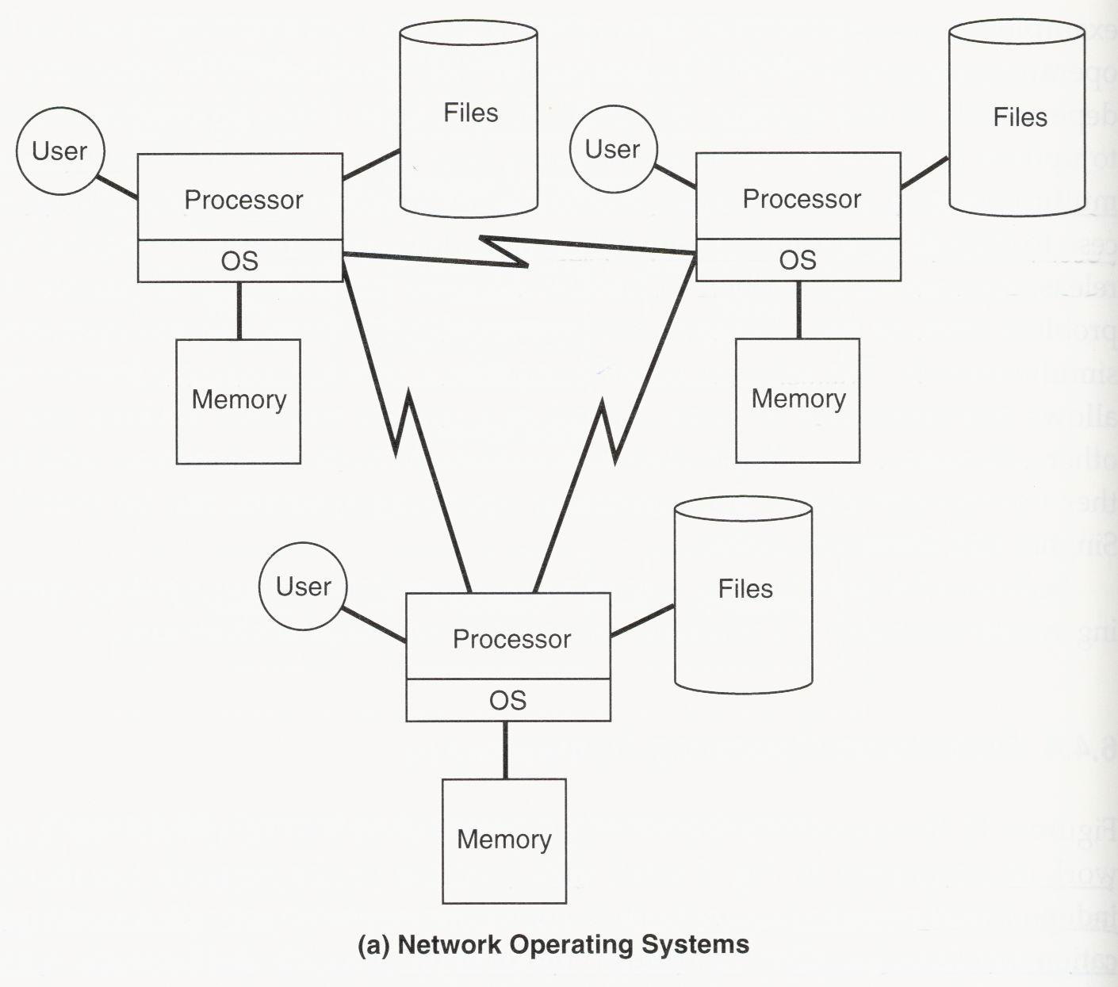
Network Operating Systems

Slide 8
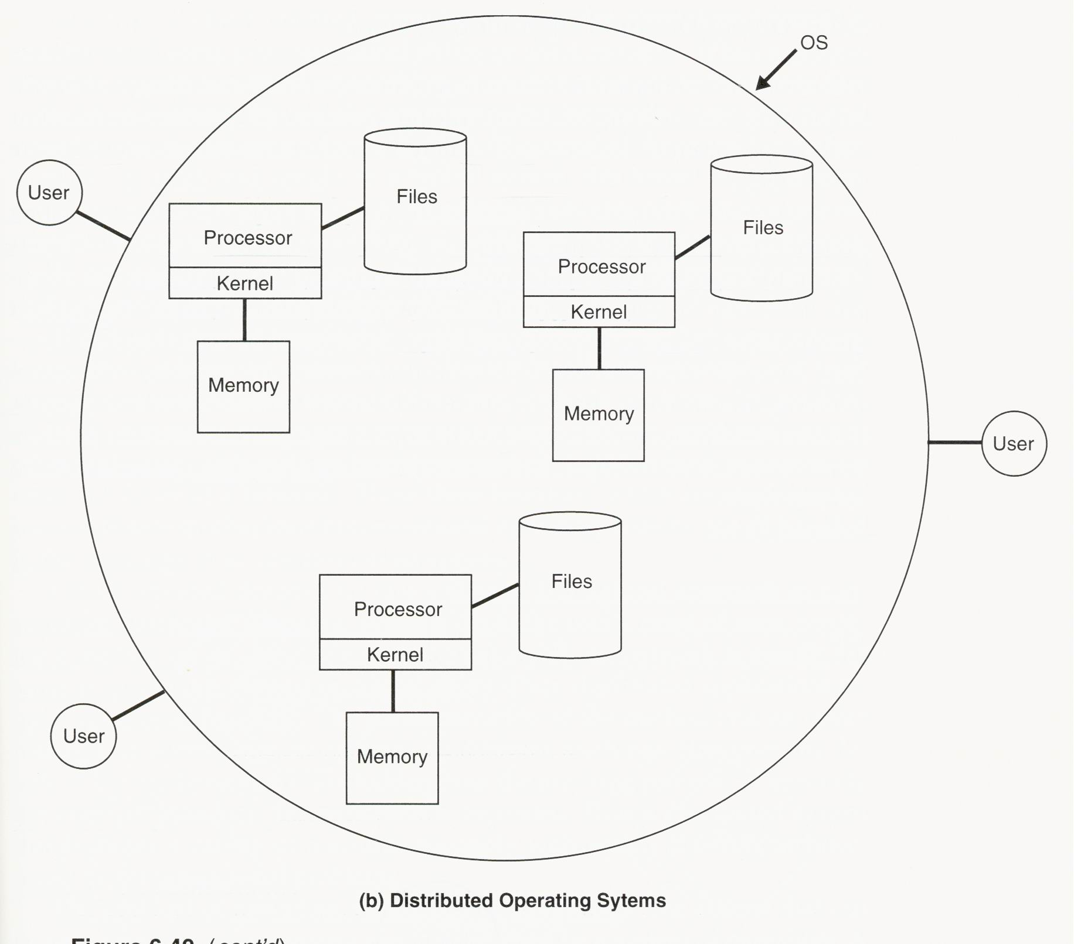
Distributed Operating Systems

Slide 9
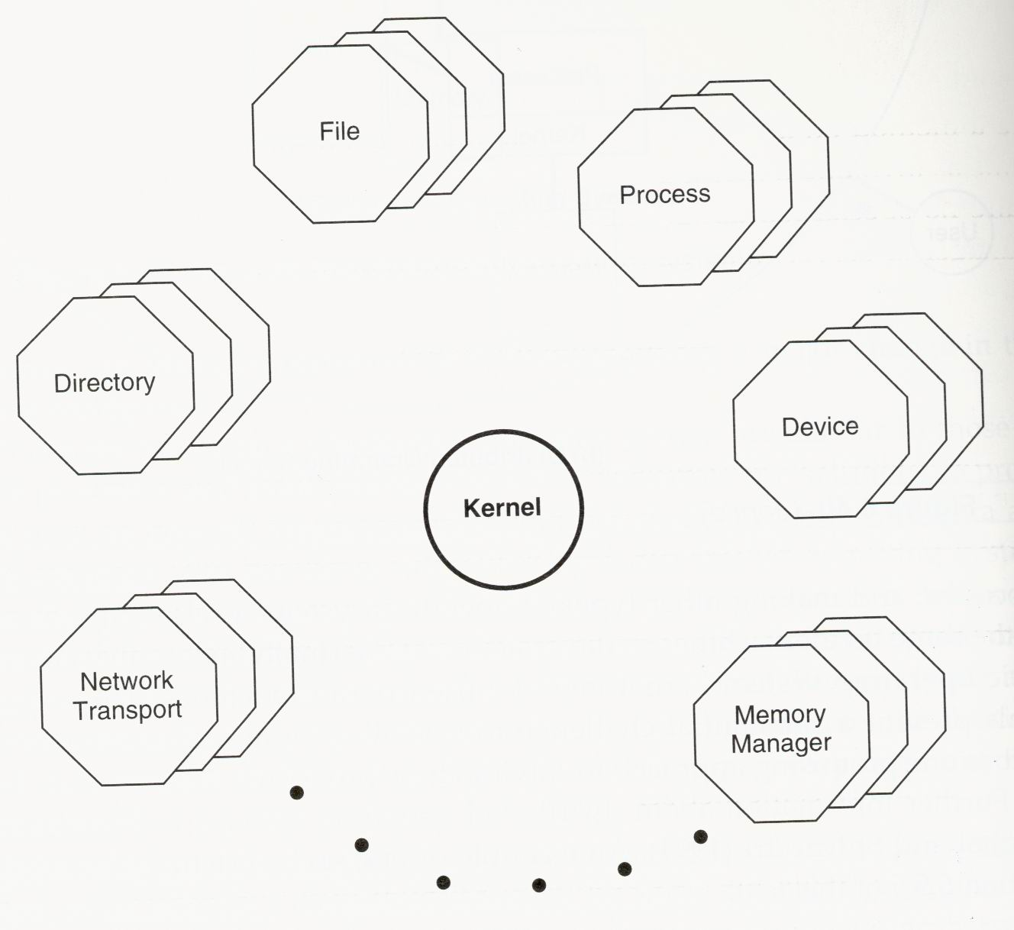
Object-Oriented Operating Systems
Most of the system is implemented as a collection of objects.
Each object encapsulates a data structure and defines a set of operations, called methods, on that data structure.

